Slide 1
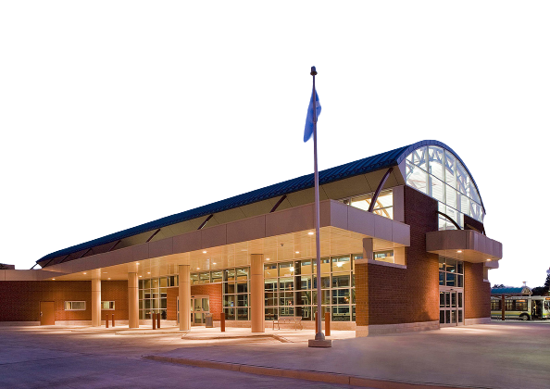
Transit Windsor
Streamlining Operations and
Improve Coordination

Slide 2
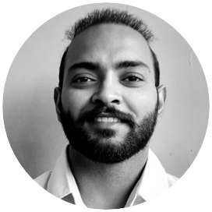

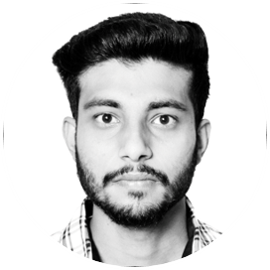
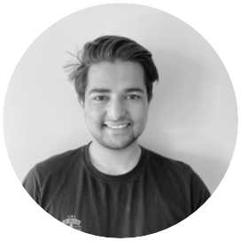
Team Three
Abhishek Rana
Krupali
Ramandeep
Shubham Sihag

Slide 3
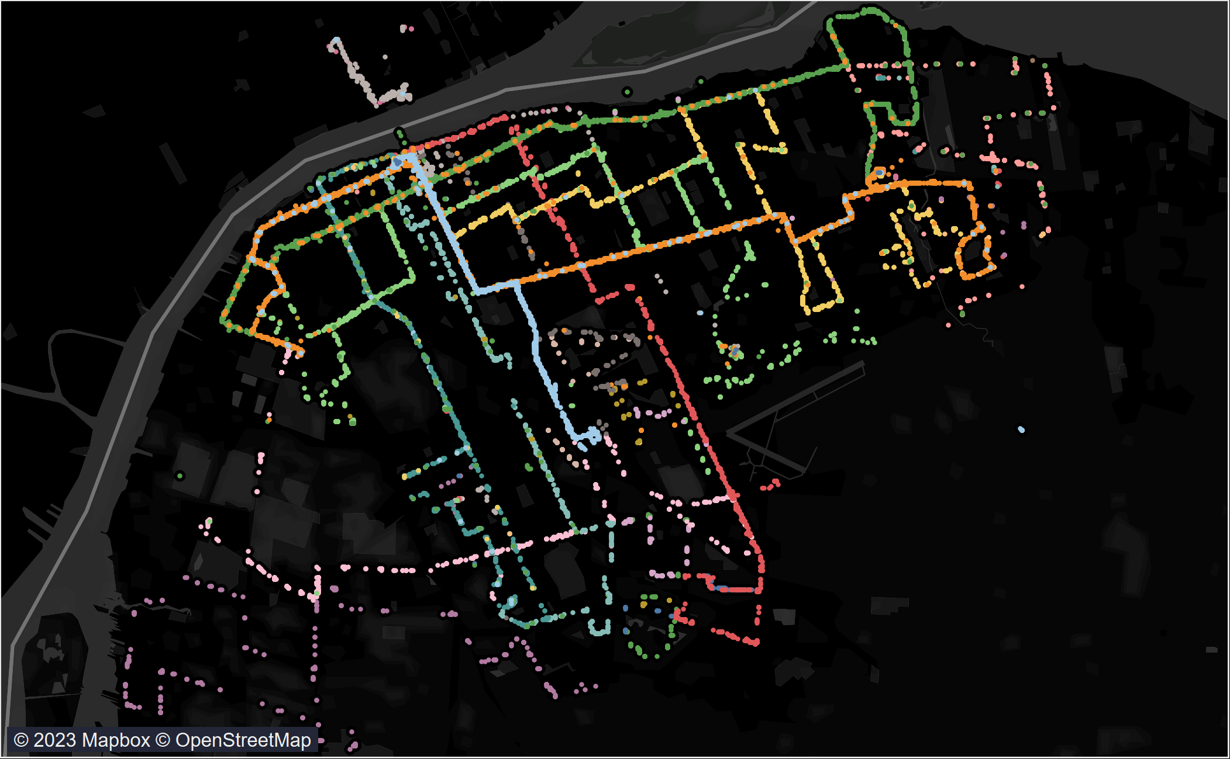
Table of Content
01. Executive Summary
02. Project Objectives
03. Timeline
05. Work Completed
06. Work to be Completed
04. Milestones
07. Budget
08. Risk and Issues
09. Conclusion and
Future Work

Slide 4
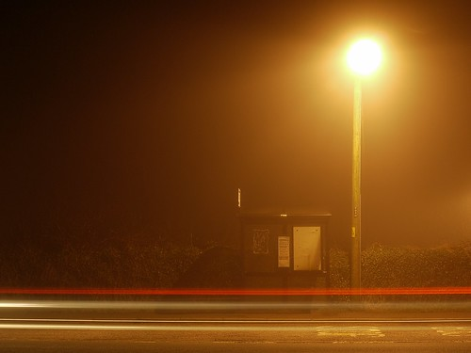
Problem Statement
We're tackling the challenges of congestion, overcrowding and limited accessibility in Windsor's transit system. Our project involves research, analysis, and planning to develop solutions for a more efficient and reliable transit service. ​

Slide 5
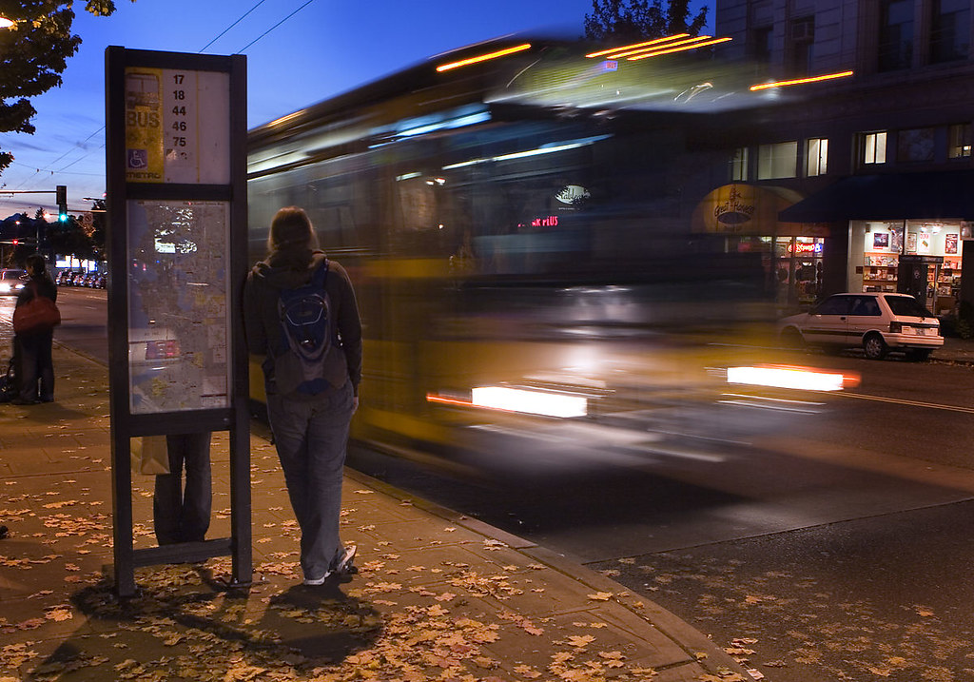
Executive summary
Our team is working with Transit Windsor to implement smart transit technologies, including a machine learning model, to address congestion and overcrowding.
Through a thorough analysis, we have assessed the feasibility and potential impact of our proposals.
Our commitment to finding innovative and data-driven solutions reflects our determination to create lasting impact in the transit industry.

Slide 6
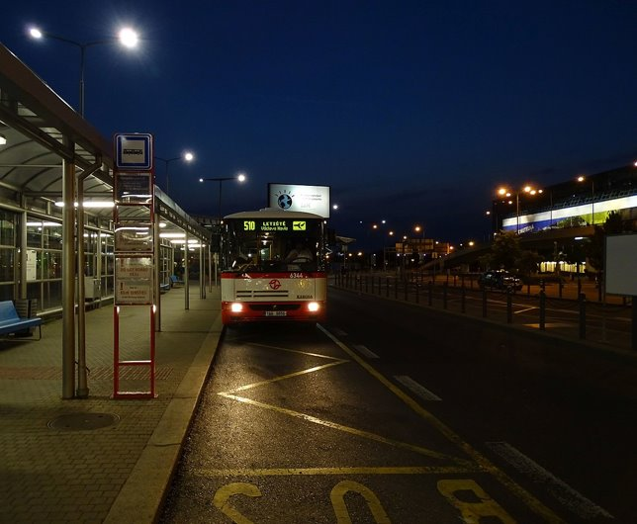
Our Objective
Our project aims to enhance Transit Windsor's reliability and efficiency by addressing congestion and overcrowding.
Proposed solutions, such as smart transit technologies, aim to optimize routes, reduce wait times, and increase customer satisfaction.
Our objectives include providing a reliable and efficient transit service that meets passenger needs and contributes to community development.

Slide 7







Project Timeline
Week 1
Team building & Research
Week 4
Business case, SWOT analysis
Week 7
Data Gathering,
Cleaning and Exploration​
Week 15
Dashboard and
Communication
Week 12
Analysis and
identifying patterns
Week 8
Data Merged and Feature Engineering
Week 9
Model Selection

Slide 8
Team Tasks
 | Tasks | Abhishek | Raman | Shubham | Krupali
Week 1 - 4 | Introduction, Team Building, Brainstorming, Group formation, Problem Statement | Worked Together | Worked Together | Worked Together | Worked Together
Week 5 | Data Gathering | Data Visualization | Data Assessment | Data Assessment | Documentation
Week 6 | Business Case and Problem Statement | EDA in Tableau/ Business Case | Problem Statement Business Case | EDA in Python Business Case | Business Case Project Charter
Week 7 | Gaining Insights, Identifying patterns and PPT 1 | Worked on PPT 1 | Data Cleaning | Worked on PPT 1 | Worked on PPT1
Week 8 | Feature Engineering, Data Merged and ML model | Data Merged | Selecting best fit ML models | Added new columns depending on ML model needs | Selecting best fit ML models
Week 9 | PPT 2 and ML Model | Worked on ML models and PPT 2 | Worked on ML models and PPT 2 | Tackled different errors occurred and did feature engineering to improve accuracy. | Worked on 2nd presentation and testing accuracy of different models

Slide 9
SWOT Analysis
WEAKNESSES
THREATS
STRENGTHS
OPPORTUNITIES
Increased competition from other transportation providers
Limited Routes and frequency of service to the community
Provide essential transportation to the community
The potential to introduce new technologies and solutions that can enhance the transit experience for riders

Slide 10
Milestones
Data Gathered
Data Assessment
Problem Statement
Data Merged
Transit Windsor aimed to enhance transportation efficiency
Data collection from Transit Windsor and Prof. John
Data assessment was done for further improvements and enhancements
The merged data enabled the identification of valuable insights for improving the transit system

Slide 11
Work Completed
To improve the efficiency of Transit Windsor, so far, we have executed the following tasks: Data gathering, cleaning, exploratory data analysis (EDA), and initial data visualization.
The relationship between variables has been investigated, and various algorithms have been applied, including linear regression and random forest regression.
A random forest classifier was also tested to determine which algorithm best fit the data. Through these analysis, the team aims to identify patterns and trends in the data that can be leveraged to improve the operations of Transit Windsor.

Slide 12
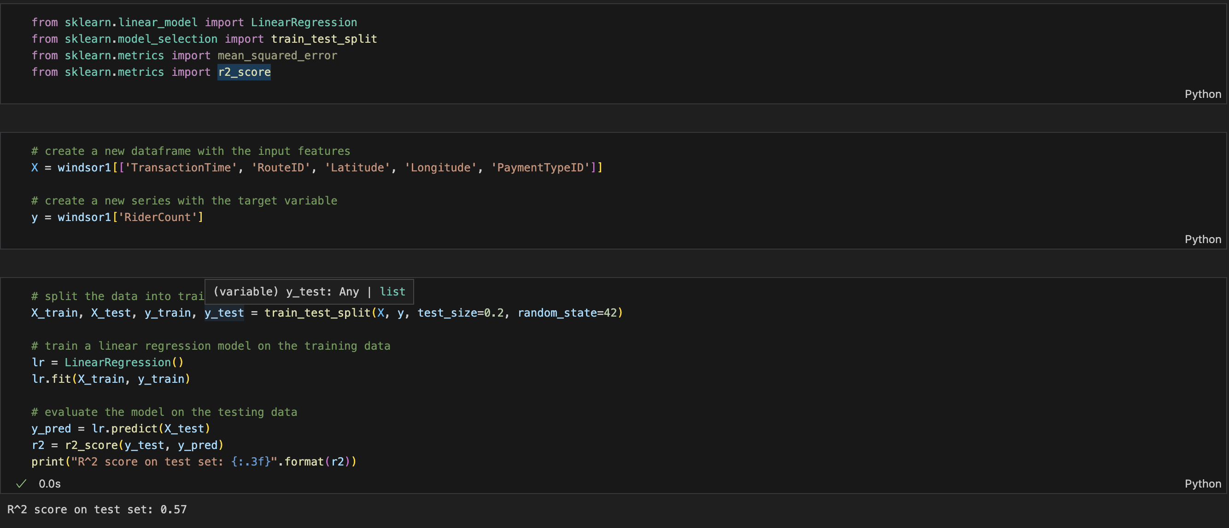
Linear Regression

Slide 13
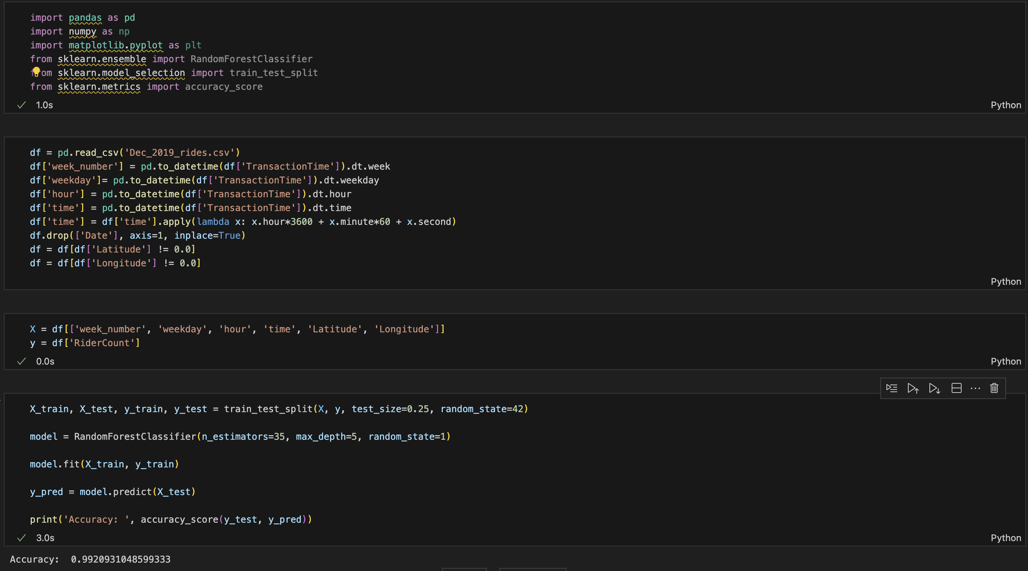
Random Forest Classifier

Slide 14
Work to be Completed
We are currently working on improving our model scores.
We are evaluating different models to identify the one that will best fit for the problem at hand.
Furthermore, we would be enhancing the accuracy of models by adding more features.
Once, the best model will be selected, the team plans to deploy it to the test set and use it to make predictions for future operations of Transit Windsor.
By doing so, we hope to optimize the transit system and provide better service to their customers.

Slide 15
Budget
Cost Types​ | Amount​
Labor Costs​ | $ 70000​
Tools and Licensing​ | $ 15000​
Consultant Fees​ | $ 20000​
Miscellaneous​ | $ 7500​

Slide 16
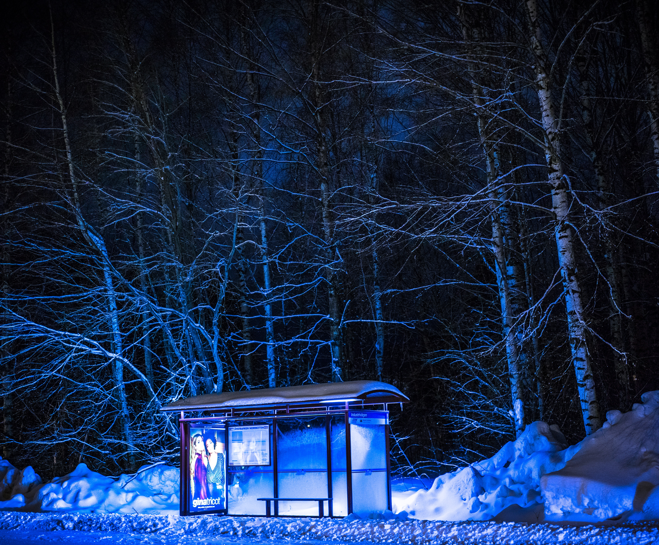
Risk and Issues
Unexpected technical or logistical issues may lead to delays or budget overruns during the implementation of the new technology.
The success of the project may be impacted if Transit Windsor staff and customers do not adopt the new technology efficiently.
The project involves significant changes to the existing transit system, which may cause resistance or reluctance among staff and customers.

Slide 17
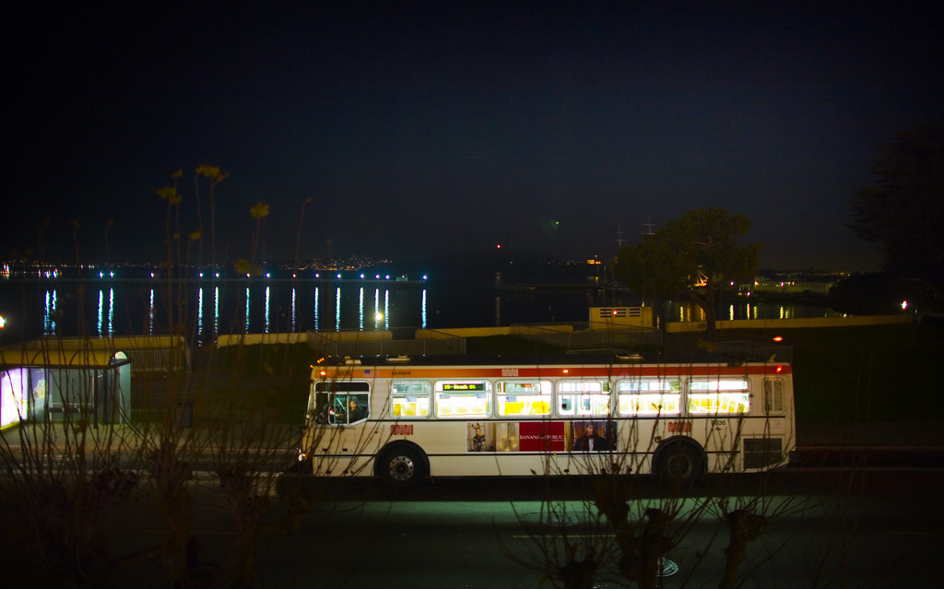
Conclusion
The Transit Windsor project has achieved key milestones in data gathering and merging, ML model selection, and feature engineering. However, there are still risks and issues to address, including implementation challenges, user adoption, and data security. With the right approach, the project can achieve its goal of modernizing and improving the transit system for customers.

Slide 18
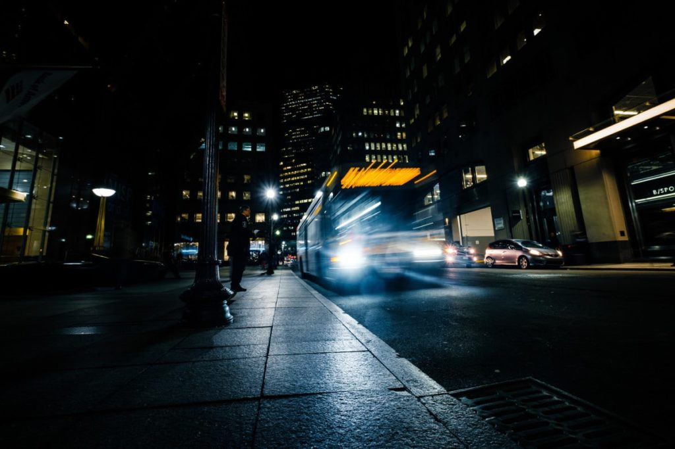
Future Work
Strengthening partnerships: We believe we could work on strengthening partnerships with other transit agencies, businesses, and organizations to create more integrated transportation options and provide more comprehensive services to riders.
Expansion: Once Windsor Transit has been integrated within Windsor-Essex county, we would expand our scope to include other cities that may share similar transportation needs.

Slide 19
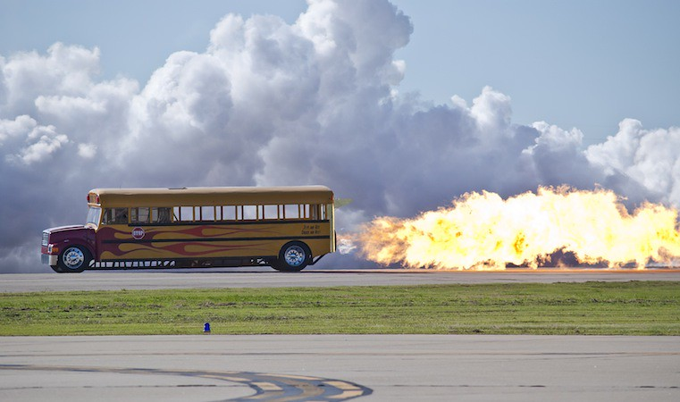
Thanks!
Do you have any questions?

